Slide 1
BASIC JAVA

Slide 2
Objectives
Gain solid Java core knowledge as the basis for further self-study
Practice applying Java features while following Java/KMS coding standard
Get into the habit of writing sufficient tests for your code
BASIC JAVA

Slide 3
CONTENTS
Language Basics
OOP Concepts
Code Conventions/Clean Code
Collections
Database Access
Date Time API (Java 8)
Helpful Features
Spring Framework Introduction
Unit testing
Common Design Patterns
BASIC JAVA

Slide 4
LANGUAGE BASICS
Data Types
Basic Operators
Control Flow Statements
Classes and Objects
Exception
LANGUAGE BASICS

Slide 5
1. DATA TYPE
JAVA is a statically typed language
Primitive Data Types: boolean, byte, short, char, int, long, float, double
Local variables don’t have default values
Do not use float and double types for currency
Be aware of type casting
Reference Data Types
Autoboxing and Unboxing(Wrapper classes)
Pass by value vs pass by reference
Mutable vs Immutable classes
LANGUAGE BASICS

Slide 6
2. BASIC OPERATORS
Arithmetic Operators: +, -, *, /, %, ++, --
Relational Operators: ==, !=, >, <, >=, <=
Bitwise Operators(work with integer types): &, |, ^, ~, <<, >>, >>>
Assignment Operator: =, +=, -=, *=, /=, %=, &=, |=, ^=, >>=, <<=, >>>=
Logical Operators: &&, ||, !
LANGUAGE BASICS

Slide 7
3. CONTROL FLOW STATEMENTS
Decision Making:
if, if else, if else if
switch: byte, short, char, int, Byte, Short, Character, Integer, Enum, String
Loop:
for (initialization; termination; increment) { statement(s) }
enhanced for loop: Collections and arrays
while (expression) { statement(s) }
do { statement(s) } while (expression);
Branching/Jumping: break, continue, return
LANGUAGE BASICS

Slide 8
4. CLASSES AND OBJECTS
public class Bicycle {
private int id;
private int gear;
private int speed;
protected static int numberOfBicycles = 100;
public Bicycle(int gear, int speed) {
id = ++numberOfBicycles;
this.gear = gear;
this.speed = speed;
}
public int getId() {
return id;
}
public int getGear() {
return gear;
}
public void setGear(int newValue) {
gear = newValue;
}
public int getSpeed() {
return speed;
}
public void applyBrake(int decrement) {
speed -= decrement;
}
public void speedUp(int increment) {
speed += increment;
}
}
public class MountainBike extends Bicycle {
private int seatHeight;
public MountainBike(int gear, int speed, int seatHeight) {
super(gear, speed);
this.seatHeight = seatHeight;
}
public static void printNumberOfBicycles() {
System.out.println(numberOfBicycles);
}
public void setSeatHeight(int seatHeight ) {
this.seatHeight = seatHeight;
}
public int getSeatHeight() {
return seatHeight;
}
}
public class App {
public static void main(String... args) {
MountainBike.printNumberOfBicycles();
}
}
LANGUAGE BASICS

Slide 9
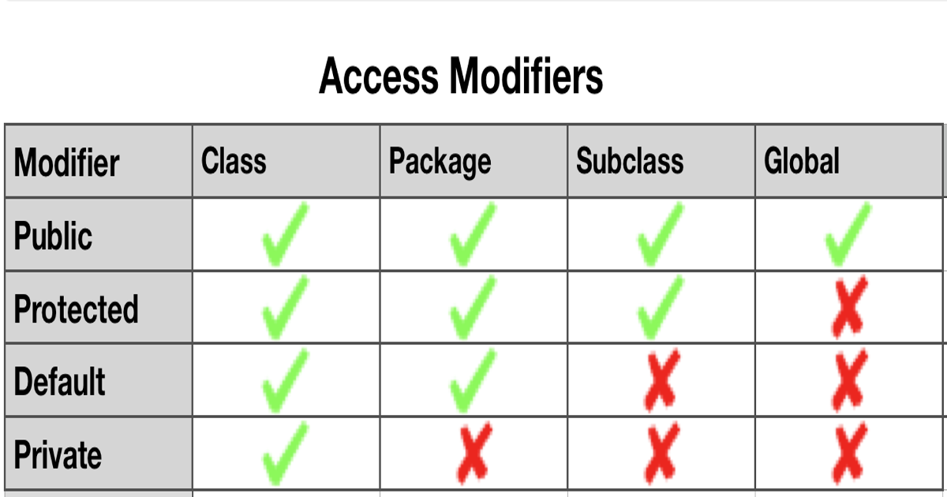
4. CLASSES AND OBJECTS
Field vs Property vs Variable
Constructor (new, this, super)
Overloading - Method signature: method name and a parameter list (number of parameters, type of the parameters and order of the parameters)
Varargs
Access Modifiers
Class level
Member level
Class Members
LANGUAGE BASICS

Slide 10
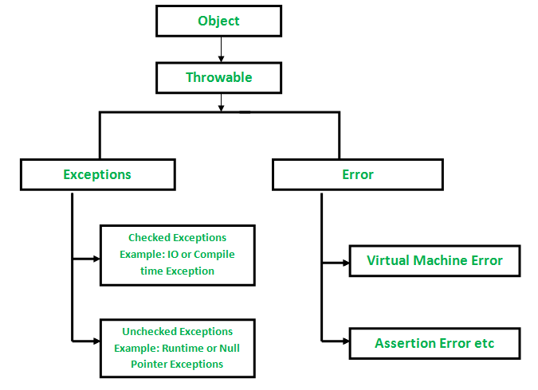
5. EXCEPTION - Category
Checked Exception: checked at compile time
Unchecked Exception: not checked at compile time
Error: external to the application
RuntimeException: internal to the application, usually indicate programming bugs
If a client can reasonably be expected to recover from an exception, make it a checked exception. If a client cannot do anything to recover from the exception, make it an unchecked exception
LANGUAGE BASICS

Slide 11
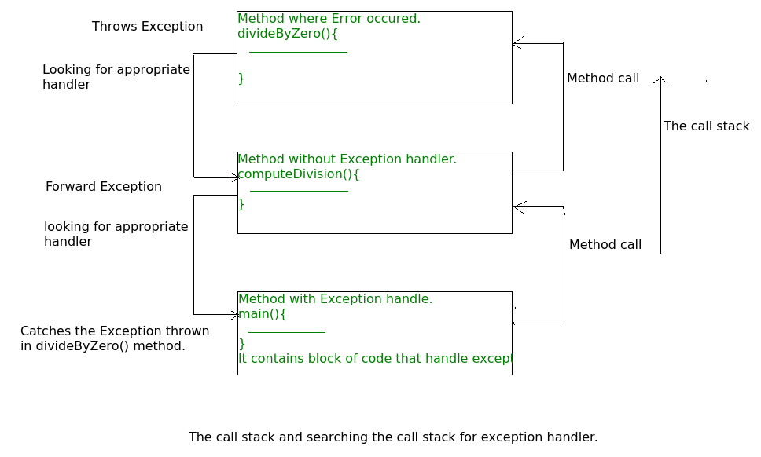
5. EXCEPTION - Call Stack
LANGUAGE BASICS

Slide 12
5. EXCEPTION - Handling
try, catch, finally
try-with-resources
A resource is an object that must be closed after the program is finished with it
Any catch or finally block is run after the resources declared have been closed
exception logging, rethrowing practices
should not suppress caught exceptions with blank catch blocks
prevent missing stack traces
LANGUAGE BASICS

Slide 13
5. EXCEPTION
private static final Logger LOGGER = LoggerFactory.getLogger(MyApplication.class);
public void writeList(List<String> list) throws IOException {
PrintWriter out = null;
try { // try (PrintWriter out = new PrintWriter(new FileWriter("OutFile.txt"))) {
out = new PrintWriter(new FileWriter("OutFile.txt"));
for (int i = 0; i < list.size(); i++) {
out.println("Value at: " + i + " = " + list.get(i));
}
} catch (IndexOutOfBoundsException e) {
LOGGER.error("Caught IndexOutOfBoundsException:{} ", e.getMessage());
throw e;
} catch (IOException e) {
LOGGER.error("Caught IOException: {} ", e.getMessage());
throw e;
} finally {
LOGGER.info(“Finally block”);
if (out != null) {
out.close();
}
}
}
LANGUAGE BASICS

Slide 14
REFERENCES
Overall:
https://docs.oracle.com/javase/tutorial/reallybigindex.html
https://www.geeksforgeeks.org/java/?ref=lbp
https://docs.oracle.com/javase/8/docs/api/index.html?overview-summary.html
Language Basic:
https://www.geeksforgeeks.org/data-types-in-java/?ref=lbp
https://www.geeksforgeeks.org/basic-operators-java/?ref=rp
https://docs.oracle.com/javase/tutorial/java/nutsandbolts/flow.html
https://docs.oracle.com/javase/tutorial/java/javaOO/index.html
https://docs.oracle.com/javase/tutorial/essential/exceptions/index.html
https://www.geeksforgeeks.org/exceptions-in-java/?ref=lbp
LANGUAGE BASICS

Slide 15
II. OOP CONCEPTS
Inheritance
Polymorphism
Encapsulation
Abstraction
II. OOP CONCEPTS

Slide 16
1. INHERITANCE - Define
Classes can inherit commonly used state and behavior from other classes
Each class is allowed to have one direct superclass and unlimited number of subclasses
Constructors are not inherited, but the constructor of the superclass can be invoked from the subclass
A subclass does not inherit the private members of its parent class
Casting Objects: shows the use of an object of one type in place of another type, among the objects permitted by inheritance and implementations
II. OOP CONCEPTS

Slide 17
1. INHERITANCE - Overridden
Instance method in the subclass that has the same signature as the one in the superclass
The access modifier for an overriding method can allow more, but not less, access than the overridden method
Final, static, private, constructor methods can not be overridden
The overriding method must have same return type (or subtype)
If the super-class method does not throw an exception, subclass method can only throws the unchecked exception
If the super-class method does throws an exception, subclass method can only throw same, subclass, unchecked exception or not throwing any exception
II. OOP CONCEPTS

Slide 18
1. INHERITANCE - Interface
A contract between a class and the outside world, where the class promises to provide the behavior published by that interface
Can extend any number of interfaces
Can contain abstract, default and static methods, all are implicitly public
Can contain constants, all are public, static, final implicitly
Default methods enable you to add new functionality to the interfaces of your libraries and ensure binary compatibility with code written for older versions of those interfaces
II. OOP CONCEPTS

Slide 19
2. POLYMORPHISM
class Animal {
protected void run() {
System.out.println("An animal is running");
}
protected void call() {
System.out.println("An animal is calling for you");
}
}
class Dog extends Animal {
public void call(){
System.out.println("Woof!!!");
}
}
class Cat extends Animal {
public void call(){
System.out.println("Meow!!!");
}
}
class TestPolymorphism {
public static void main(String[] args) {
List<Animal> animalList = Arrays.asList(new Dog(), new Cat());
for (Animal animal : animalList) {
animal.run();
animal.call();
}
}
}
II. OOP CONCEPTS

Slide 20
3. ENCAPSULATION
Define
The wrapping up of data under a single unit
Can be achieved by declaring all the variables in the class as private and writing public methods in the class to set and get the values of variables
Advantages
Data Hiding: It will not be visible to the user that how the class is storing values in the variables
Increased Flexibility: We can make the variables of the class as read-only or write-only depending on our requirement
Reusability: Encapsulation also improves the re-usability and easy to change with new requirements
Easy testing: Encapsulated code is easy to test for unit testing
II. OOP CONCEPTS

Slide 21
4. ABSTRACTION
Define
Only the essential information is displayed, details of implementation is hidden
In java, abstraction is achieved by interfaces and abstract classes
Encapsulation is data hiding(information hiding) while Abstraction is detail hiding(implementation hiding)
Advantages
Reduces the complexity of viewing the things
Avoids code duplication and increases reusability
Helps to increase security of an application or program
Consider using abstract classes
You want to share code among several closely related classes
You expect that classes that extend your abstract class have many common methods or fields, or require access modifiers other than public
You want to declare non-static or non-final fields. This enables you to define methods that can access and modify the state of the object to which they belong
Consider using interfaces
You expect that unrelated classes would implement your interface. For example, the interfaces Comparable and Cloneable are implemented by many unrelated classes
You want to specify the behavior of a particular data type, but not concerned about who implements its behavior
You want to take advantage of multiple inheritance of type
II. OOP CONCEPTS

Slide 22
REFERENCES
Overall:
https://docs.oracle.com/javase/tutorial/reallybigindex.html
https://www.geeksforgeeks.org/java/?ref=lbp
https://docs.oracle.com/javase/8/docs/api/index.html?overview-summary.html
OOP Concepts:
https://www.geeksforgeeks.org/classes-objects-java/?ref=lbp
https://docs.oracle.com/javase/tutorial/java/IandI/index.html
II. OOP CONCEPTS

Slide 23
III. CODE CONVENTIONS & CLEAN CODE
Codes Conventions
Clean Code
SOLID
SonarQube/SonarLint
III. CODE CONVENTIONS & CLEAN CODE

Slide 24
1. CODE CONVENTIONS
Define
Coding conventions are a set of guidelines for a specific programming language that recommend programming style, practices, and methods for each aspect of a program written in that language
Coding conventions are not enforced by compilers
Advantages
Anyone can read and understand the code as if they wrote it, thus reducing the cost of software maintenance
Improve code quality, avoid bugs or issues (security, performance ...) that are caused by bad coding practices.
A beautiful and well organized source code will show our expertise in coding
III. CODE CONVENTIONS & CLEAN CODE

Slide 25
1. CODE CONVENTIONS - Source File
Name of the top-level class it contains (exactly one), plus .java
A source file consists of, in order (exactly one blank line separates each section that is present):
License or copyright information, if present
Package statement
Import statements
Exactly one top-level class
Ordering of class contents
Different classes may order their contents in different ways. Each class uses some logical order, which its maintainer could explain if asked
When a class has multiple constructors, or multiple methods with the same name, these appear sequentially, with no other code in between (not even private members)
III. CODE CONVENTIONS & CLEAN CODE

Slide 26
1. CODE CONVENTIONS - Formatting
Braces are used with if, else, for, do and while statements, even when the body is empty or contains only a single statement (Egyptian brackets)
indentation: 2 or 4 spaces without using tab
Line limit: 80, 100, 120…
Grouping parentheses: recommended
One statement per line, one variable per declaration, except in the header of a for loop
III. CODE CONVENTIONS & CLEAN CODE

Slide 27
1. CODE CONVENTIONS - Whitespace
Separating any reserved word, such as if, else, for or catch from an open parenthesis (() or a closing curly brace (})
On both sides of any binary or ternary operator. This also applies to the following "operator-like" symbols:
the pipe for a catch block that handles multiple exceptions: catch (FooException | BarException e)
the colon (:) in an enhanced for ("foreach") statement
the arrow in a lambda expression: (String str) -> str.length()
but not
the two colons (::) of a method reference, which is written like Object::toString
the dot separator (.), which is written like object.toString()
On both sides of the double slash (//) that begins an end-of-line comment
Between the type and variable of a declaration: List<String> list
III. CODE CONVENTIONS & CLEAN CODE

Slide 28
1. CODE CONVENTIONS - Naming
Package: all lowercase
Class: UpperCamelCase, typically nouns or noun phrases
Interface: UpperCamelCase, may be nouns or noun phrases, but may sometimes be adjectives or adjective phrases
Method: lowerCamelCase, typically verbs or verb phrases
Underscores may appear in test method names, but there is no One Correct Way to name test methods
Constant: CONSTANT_CASE
Non-constant field: lowerCamelCase, typically nouns or noun phrases
Parameter: lowerCamelCase, One-character parameter names in public methods should be avoided
Local variable: lowerCamelCase
III. CODE CONVENTIONS & CLEAN CODE

Slide 29
1. CODE CONVENTIONS
Programming Practices
@Override: always used
Caught exceptions: not ignored
Static members: qualified using class
Local variables: declare close to the point they are first used to minimize their scope
Switch statements:
comment Fall-through
should have the default case
III. CODE CONVENTIONS & CLEAN CODE

Slide 30
2. CLEAN CODE - Naming is difficult
“Clean code is code that is easy to understand and easy to change”
Use self-explanatory names, example: elapsedTimeInDays, fileAgeInDays, daysSinceCreation
Consider prefix Boolean with “Can”, “Is” or “Has”
Do not afraid of long name, the length of a name should correspond to the size of its scope, so we can search it
Do not include the parent class name within a property name
Avoid disinformation, example: do not refer to a group of object as List unless it is actually a List
Avoid names vary in small ways like Customer/Customers/CustomerObject
Pick one word per concept. For example. Pick one out of get/fetch/receive and stick with it
III. CODE CONVENTIONS & CLEAN CODE

Slide 31
2. CLEAN CODE - Method
Should be small and do only one thing (one level of abstraction)
Have no side effects
Public methods must validate their input arguments
Reducing the number of arguments by creating objects out of them
Avoid flag argument, split into multiple methods
Use argument list Integer... args, Object... args, etc
Prefer Polymorphism over If/Else or Switch
DRY (Don’t Repeat Yourself): refactor common code into new methods of same or different class
III. CODE CONVENTIONS & CLEAN CODE

Slide 32
2. CLEAN CODE - Exception Handling
Throw specific custom Exceptions instead of generic ones
Catch Exceptions when there is enough information to handle them
Consider to throwing an exception or returning a Special Case (Object that has the same interface as what the caller expects) instead of returning null, example: empty collection instead of null
Do not use exception as a flow control structure. Exceptions are for exceptional cases only
III. CODE CONVENTIONS & CLEAN CODE

Slide 33
2. CLEAN CODE - Comment
Use English for all code comments
Use for clarification, warning of consequences
Write comments which describe what the code does and/or why it does that, not how the code works
Don’t comment bad code, rewrite it!
TODO Comment
Remove unused code from the source file instead of commenting it out
III. CODE CONVENTIONS & CLEAN CODE

Slide 34
3. SOLID
Classes should be designed in a loosely coupled way. Loosely coupled means changes in one class should not force other classes to change
Single Responsibility Principle
A class should have only one reason to change
The more instance variables a method manipulates, the more cohesive that method is to its class, breaking a large method into many smaller methods often gives us opportunity to split several smaller classes out as well
Open/Close Principle
“software entities (classes, modules, functions, etc.) should be open for extension, but closed for modification"
Liskov Substitution Principle
"Objects in a program should be replaceable with instances of their subtypes without altering the correctness of that program."
Interface Segregation Principle
A client should not be exposed to methods it doesn’t need
Dependency Inversion Principle
High-level modules should not depend on low-level modules. Both should depend on the abstraction.
Abstractions should not depend on details. Details should depend on abstractions
III. CODE CONVENTIONS & CLEAN CODE

Slide 35
4. SONARQUBE/SONARLINT
SonarQube
An open-source platform used for continuous inspection of code quality
Offers reports on duplicated code, coding standards, unit tests, code coverage, code complexity, comments, bugs, and security vulnerabilities
Sonarlint
An IDE extension that helps you detect and fix quality issues as you write code
III. CODE CONVENTIONS & CLEAN CODE

Slide 36
REFERENCES
Overall:
https://docs.oracle.com/javase/tutorial/reallybigindex.html
https://www.geeksforgeeks.org/java/?ref=lbp
https://docs.oracle.com/javase/8/docs/api/index.html?overview-summary.html
Code Conventions & Clean Code:
https://en.wikipedia.org/wiki/Coding_conventions
https://google.github.io/styleguide/javaguide.html
https://rules.sonarsource.com/java
https://en.wikipedia.org/wiki/SOLID
Clean Code by Robert C. Martin
III. CODE CONVENTIONS & CLEAN CODE

Slide 37
IV. COLLECTIONS
Big O notation
Collections Framework
Iterable
List vs Map vs Set
Stream API
IV. COLLECTIONS

Slide 38
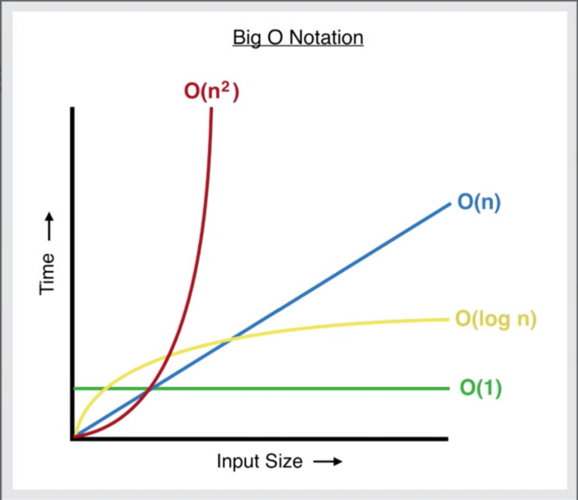
1. BIG O NOTATION - Define
A mathematical notation that describes the limiting behavior of a function when the argument tends towards a particular value or infinity.
In computer science, big O notation is used to classify algorithms according to how their run time or space requirements grow as the input size grows
IV. COLLECTIONS

Slide 39
1. BIG O NOTATION - Calculate
Break your algorithm/function into individual operations
Calculate the Big O of each operation
Add up the Big O of each operation together
Remove the constants
Find the highest order term — this will be what we consider the Big O of our algorithm/function
IV. COLLECTIONS

Slide 40
1. BIG O NOTATION - Analysis of Loops
O(1) no loop
O(n) the loop variables is incremented / decremented by a constant amount
O(n^c) nested loops is equal to the number of times the innermost statement is executed
O(Logn) the loop variables is divided / multiplied by a constant amount
O(LogLogn) the loop variables is reduced / increased exponentially by a constant amount
IV. COLLECTIONS

Slide 41
2. Collections Framework
A collection is simply an object that groups multiple elements into a single unit
Consistent API: The API has a basic set of interfaces like Collection, Set, List, or Map, all the classes (ArrayList, LinkedList, Vector, etc) that implement these interfaces have some common set of methods
Reduces programming effort: A programmer doesn’t have to worry about the design of the Collection but rather he can focus on its best use in his program
Increases program speed and quality: Increases performance by providing high-performance implementations of useful data structures and algorithms
Collections is a utility class
IV. COLLECTIONS

Slide 42
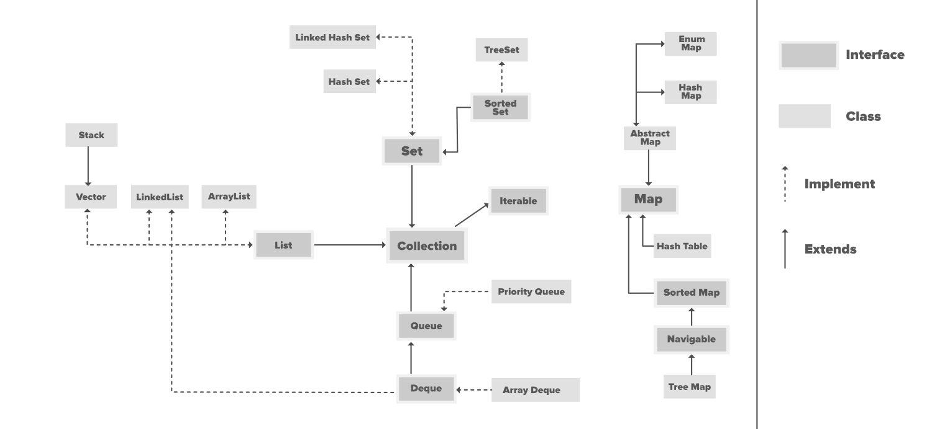
2. Collections Framework
IV. COLLECTIONS

Slide 43
3. Iterable
Provide an Iterator which is an object that enables you to traverse through a collection and to remove elements from the collection selectively
For loop with indices isn't always possible
The foreach loop uses an Iterator behind the scenes
An Iterator can do things that a foreach loop can't. For example, remove elements while iterating. List also offers iterators that can iterate in both directions
Using indices to access elements is slightly more efficient with collections backed by an array. But if the code changes from a ArrayList to LinkedList, the performance will be awful
An Iterator (and thus the foreach loop) always uses the best possible way to iterate through elements of the given collection
Iterator is more dangerous and less readable
Use the foreach loop, unless really need capabilities of an Iterator, only use for loop with indices when need access to the index inside the loop
IV. COLLECTIONS

Slide 44
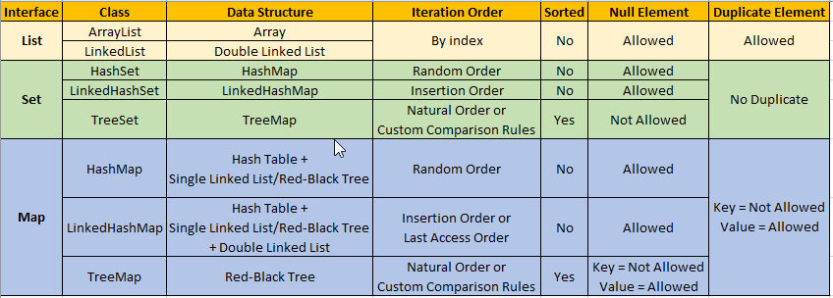
4. List vs Map vs Set
IV. COLLECTIONS

Slide 45
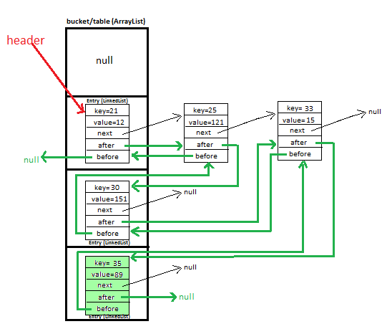
4. List vs Map vs Set
IV. COLLECTIONS

Slide 46
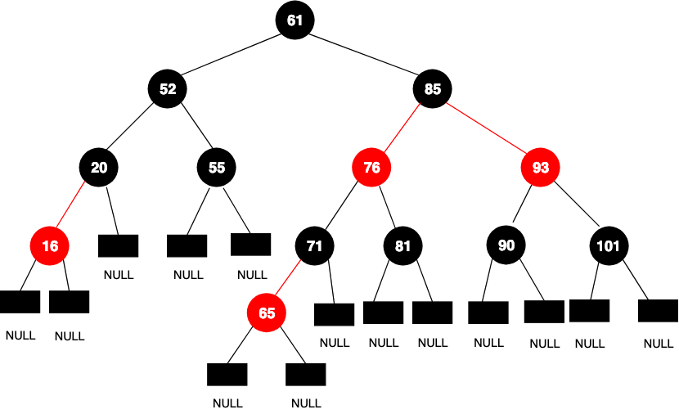
4. List vs Map vs Set
IV. COLLECTIONS

Slide 47
4. List vs Map vs Set
Not allowed primitive type
equals()
reflexive: an object must equal itself
symmetric: x.equals(y) must return the same result as y.equals(x)
transitive: if x.equals(y) and y.equals(z) then also x.equals(z)
consistent: the value of equals() should change only if a property that is contained in equals() changes (no randomness allowed)
hashCode() returns an integer representing the current instance
internal consistency: the value of hashCode() may only change if a property that is in equals() changes
equals consistency: objects that are equal to each other must return the same hashCode
collisions: unequal objects may have the same hashCode
IV. COLLECTIONS

Slide 48
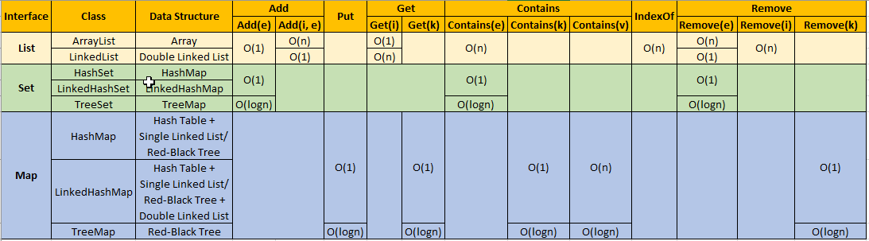
4. List vs Map vs Set
IV. COLLECTIONS

Slide 49
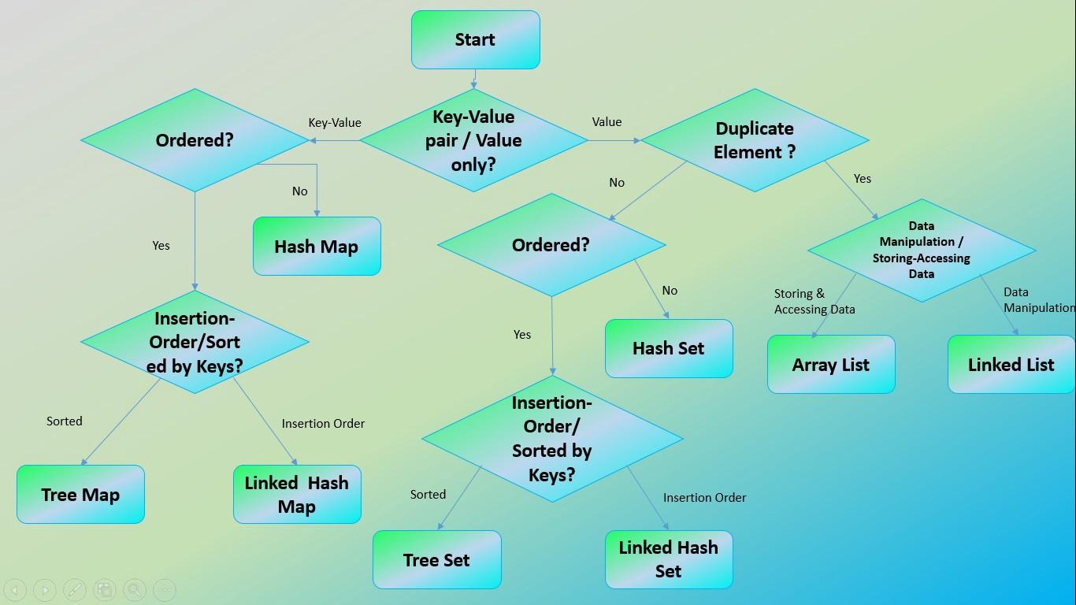
4. List vs Map vs Set
IV. COLLECTIONS

Slide 50
5. Stream API - Stream
A sequence of objects that supports various methods which can be pipelined
Not a data structure
Not altering the original value of the object
Advantage
Readability (not always)
Support processing multiple elements at the same time, but multithreading comes with a significant overhead. So if data source is not big, it might be slower in total
IV. COLLECTIONS

Slide 51
5. Stream API - Pipeline components
A stream source: collections, arrays, any data source that can suitably provide access to its elements(with a Spliterator)
Zero or more intermediate operations: transform streams into other streams
filtering the elements - filter(),
transforming the elements - map(),
sorting the elements - sorted(),
A terminal operation
aggregations - reduce() or collect()
searching - findFirst()
iteration - forEach()
IV. COLLECTIONS

Slide 52
5. Stream API - Pipeline execution
Stream pipelines are constructed lazily.
Constructing a stream source doesn’t compute the elements of the stream, but instead captures how to find the elements when necessary.
Invoking an intermediate operation doesn’t perform any computation on the elements; it merely adds another operation to the end of the stream description
Only when the terminal operation is invoked, the stream implementation picks an execution plan, then compute the elements, apply the intermediate operations, and apply the terminal operation
IV. COLLECTIONS

Slide 53
REFERENCES
Overall:
https://docs.oracle.com/javase/tutorial/reallybigindex.html
https://www.geeksforgeeks.org/java/?ref=lbp
https://docs.oracle.com/javase/8/docs/api/index.html?overview-summary.html
Collections:
https://www.geeksforgeeks.org/analysis-of-algorithms-set-4-analysis-of-loops/
https://www.geeksforgeeks.org/collections-in-java-2/?ref=lbp
https://docs.oracle.com/javase/tutorial/collections/index.html
https://www.geeksforgeeks.org/stream-in-java/
IV. COLLECTIONS

Slide 54
V. Database Access
JDBC
Spring JDBC
Spring Data
V. Database Access

Slide 55
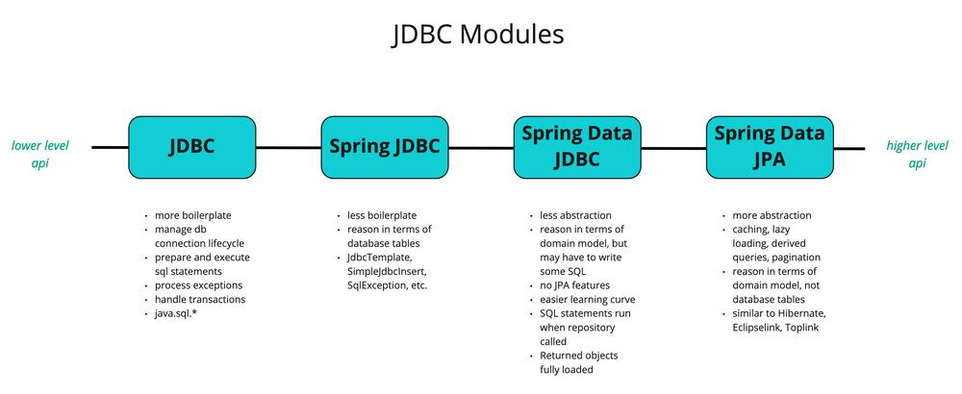
V. JDBC
V. Database Access

Slide 56
1. JDBC
Consist of 2 parts:
JDBC API is used by programmers
A low-level API called JDBC Driver is used to connect to database server
JDBC API:
Establishing a connection to relational database servers, doesn’t provide framework to connect to NoSQL databases
Send SQL queries to the Connection to be executed at database server
Process the results returned by the execution of the query
JDBC Driver type:
JDBC-ODBC Bridge plus ODBC Driver (Type 1): uses with ODBC driver
Native API partly Java technology-enabled driver (Type 2): converts JDBC class to the database client API drivers
Pure Java Driver for Database Middleware (Type 3): sends the JDBC calls to a middleware server that can connect to different type of databases
Direct-to-Database Pure Java Driver (Type 4): converts the JDBC calls to the network protocol understood by the database server, must use database specific drivers
V. Database Access

Slide 57
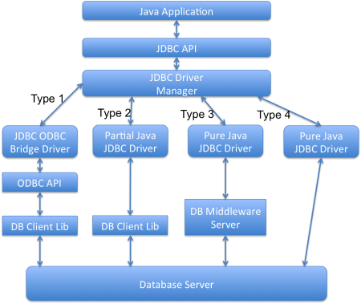
1. JDBC
V. Database Access

Slide 58
1. JDBC - PreparedStatement
PreparedStatement is faster than Statement, first 3 steps are executed when the prepared statement is created
Parsing of SQL query
Compilation of SQL Query
Planning and optimization of data acquisition path
Executing the optimized query and return the resulted data
Preventing SQL injection by automatically escapes the special characters
Execute dynamic queries with parameter inputs (indexing starts with 1)
Returns FORWARD_ONLY ResultSet
Cannot bind multiple values for single placeholder (?) -> cannot use with IN clause
V. Database Access

Slide 59
1. JDBC - Datasource & Connection Pool
DataSource is a factory for connections to the physical data source
A DataSource object has properties that can be modified when necessary
Connection Pool is a technique of creating and managing a pool of connections that are ready for use by any thread that needs them
The main benefits of connection pool
Reduced connection creation time
Simplified programming model
Controlled resource usage
V. Database Access

Slide 60
1. JDBC - Transaction Manager
By default when we create a database connection, it runs in auto-commit mode. It means that whenever we execute a query and it’s completed, the commit is fired automatically. So every SQL query we fire is a transaction and the changes are getting saved into database after every SQL statement finishes
Sometimes we want a group of SQL queries to be part of a transaction so that we can commit them when all the queries runs fine. If we get any exception, we have a choice of rollback all the queries executed as part of the transaction
JDBC Savepoint helps us in creating checkpoints in a transaction and we can rollback to that particular checkpoint
V. Database Access

Slide 61
2. Spring JDBC - JdbcTemplate
Spring JdbcTemplate is a powerful mechanism to connect to the database and execute SQL queries. It internally uses JDBC api, but eliminates a lot of problems of JDBC API
We need to write a lot of code before and after executing the query, such as creating connection, statement, closing resultset, connection etc
We need to perform exception handling code on the database logic
We need to handle transaction
Repetition of all these codes from one to another database logic is a time consuming task
V. Database Access

Slide 62
3. Spring Data
Spring-Data is an umbrella project that provides a common API to define how to access data (DAO + annotations) in a more generic way, covering both SQL and NOSQL data sources
The initial idea is to provide a technology so that the developer writes the interface for a DAO (finder methods) and the entity classes in a technology-agnostic way and, based on configuration only (annotations on DAOs & entities + spring configuration, be it xml- or java-based), decides the implementation technology
Some abstractions provided by Spring Data are:
CRUD: Automatically implements Repository Pattern with basic CRUD operations
Derived Queries: Automatically implements methods from interface method name and parameters
Pagination and Sorting: Automatically implemented methods for paginating data. Available as extension to Derived Queries
V. Database Access

Slide 63
REFERENCES
Overall:
https://docs.oracle.com/javase/tutorial/reallybigindex.html
https://www.geeksforgeeks.org/java/?ref=lbp
https://docs.oracle.com/javase/8/docs/api/index.html?overview-summary.html
JDBC:
https://docs.oracle.com/javase/tutorial/jdbc/index.html
V. Database Access

Slide 64
VI. DATE TIME API JAVA 8
Problem & Core Ideas
LocalDate
LocalTime
LocalDateTime
ZonedDateTime
Period & Duration & Instant
VI. DATE TIME API JAVA 8

Slide 65
1. Problem & Core Ideas
Problem with old APIs
Not thread safe
Less operations with poor design
java.util.Date years start at 1900, months start at 1, and days start at 0
java.util.Date represents an instant on the timeline—a wrapper around the number of milli-seconds since the UNIX epoch—but if you call toString(), the result suggests that it has a time zone, causing confusion
Need additional logic to handle timezone logic
The new API is driven by three core ideas
Immutable-value classes
Domain-driven design
Separation of chronologies: allows to work with different calendaring systems that don’t necessarily follow ISO-8601
VI. DATE TIME API JAVA 8

Slide 66
2. LocalDate
Creating
LocalDate.now();
LocalDate.of(2015, 02, 20);
LocalDate.parse("2015-02-20");
Adjust
LocalDate tomorrow = LocalDate.now().plusDays(1);
LocalDate previousMonthSameDay =
LocalDate.now().minus(1, ChronoUnit.MONTHS);
Get constituent value
DayOfWeek sunday = LocalDate.parse("2016-06-12").getDayOfWeek();
int twelve = LocalDate.parse("2016-06-12").getDayOfMonth();
Check leap year
boolean leapYear = LocalDate.now().isLeapYear();
Compare
boolean isAfter =
LocalDate.parse("2016-06-12")
.isAfter(LocalDate.parse("2016-06-11"));
Get boundaries
LocalDateTime beginningOfDay =
LocalDate.parse("2016-06-12")
.atStartOfDay();
LocalDate firstDayOfMonth =
LocalDate.parse("2016-06-12")
.with(TemporalAdjusters.firstDayOfMonth());
VI. DATE TIME API JAVA 8

Slide 67
3. LocalTime
Creating
LocalTime now = LocalTime.now();
LocalTime.of(6, 30);
LocalTime.parse("06:30");
Adjust
LocalTime sevenThirty = LocalTime.parse("06:30").plus(1, ChronoUnit.HOURS);
Get constituent value
int six = LocalTime.parse("06:30").getHour();
Compare
boolean isbefore =
LocalTime.parse("06:30")
.isBefore(LocalTime.parse("07:30"));
Get prefix time
LocalTime minTime = LocalTime.MIN
LocalTime maxTime = LocalTime.MAX
LocalTime midnightTime = LocalTime.MIDNIGHT
LocalTime noonTime = LocalTime.NOON
VI. DATE TIME API JAVA 8

Slide 68
4. LocalDateTime
Creating
LocalDateTime.now();
LocalDateTime.of(2015, Month.FEBRUARY, 20, 6, 30);
LocalDateTime.parse("2015-02-20T06:30:00");
Adjust
localDateTime.plusDays(1);
localDateTime.minusHours(2);
Get constituent value
localDateTime.getMonth();
Compare
boolean isEqual =
LocalDateTime.of(2015, Month.FEBRUARY, 20, 6, 30)
.isEqual(LocalDateTime.parse("2015-02-20T06:30:00"));
VI. DATE TIME API JAVA 8

Slide 69
5. ZonedDateTime
Get all available zone id
ZoneId.getAvailableZoneIds();
Creating
ZoneId.systemDefault();
ZoneId.of("Europe/Paris");
ZoneId.ofOffset(“GMT”, ZoneOffset.ofHours(7));
ZonedDateTime.of(localDateTime, zoneId);
ZonedDateTime.parse("2015-05-03T10:15:30+01:00[Europe/Paris]");
Convert
ZonedDateTime destZonedDateTime = sourceZonedDateTime.withZoneSameInstant(destZoneId);
VI. DATE TIME API JAVA 8

Slide 70
6. Period & Duration & Instant
Period represents a quantity of time in terms of years, months and days
LocalDate finalDate = initialDate.plus(Period.ofDays(5));
Get value from Period
Period.between(startDate,endDate).getDays();
ChronoUnit.DAYS.between(startDate, endDate);
Duration represents a quantity of time in terms of seconds and nano seconds
LocalTime finalTime = initialTime.plus(Duration.ofSeconds(30));
Get value from Duration
Duration.between(startTime, endTime).getSeconds();
ChronoUnit.SECONDS.between(startTime, endTime);
Instant helps to convert existing Date and Calendar instance to new Date Time API
LocalDateTime.ofInstant(date.toInstant(), ZoneId.systemDefault());
LocalDateTime.ofInstant(calendar.toInstant(), ZoneId.systemDefault());
VI. DATE TIME API JAVA 8

Slide 71
REFERENCES
Overall:
https://docs.oracle.com/javase/tutorial/reallybigindex.html
https://www.geeksforgeeks.org/java/?ref=lbp
https://docs.oracle.com/javase/8/docs/api/index.html?overview-summary.html
Date/Time API Java 8:
https://www.baeldung.com/java-8-date-time-intro
https://www.tutorialspoint.com/java8/java8_datetime_api.htm
VI. DATE TIME API JAVA 8

Slide 72
VII. HELPFUL FEATURES
Generics
Lambda Expression
Functional Interface
Java IO
Annotation
Regular Expressions
VII. HELPFUL FEATURES

Slide 73
1. Generics
Use type as parameter when defining methods, classes, and interfaces
Object can refer to any type, but lack type safety
Convention:
E - Element (used extensively by the Java Collections Framework)
K - Key
N - Number
T - Type
V - Value
S,U,V etc. - 2nd, 3rd, 4th types
Cannot use with primitive types
Raw type: the actual type argument is omitted
Bounded Type Parameters used to restrict the types that can be used
The question mark (?), called the wildcard, represents an unknown type
VII. HELPFUL FEATURES

Slide 74
2. Lambda Expression - Definition
Lambda expressions basically express instances of functional interfaces (An interface with single abstract method)
Lambda expressions implement the only abstract function and therefore implement functional interfaces
Enable to treat functionality as a method argument, or code as data
A function that can be created without belonging to any class
A lambda expression can be passed around as if it was an object and executed on demand
VII. HELPFUL FEATURES

Slide 75
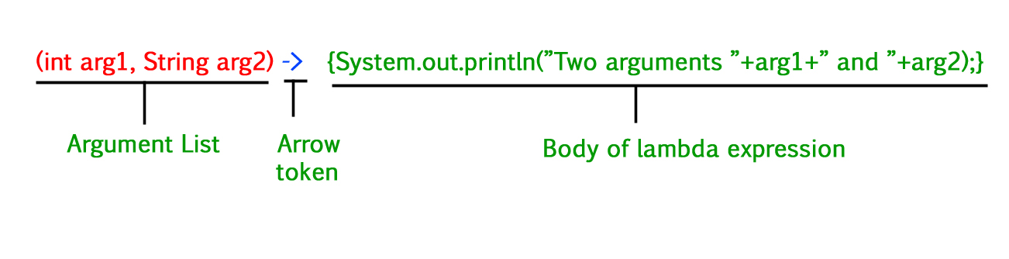
2. Lambda Expression - Syntax
The body can contain zero, one or more statements.
When there is a single statement curly brackets are not mandatory and the return type of the anonymous function is the same as that of the body expression.
When there are more than one statements, then these must be enclosed in curly brackets (a code block) and the return type of the anonymous function is the same as the type of the value returned within the code block, or void if nothing is returned
Method references are lambda expressions for methods that already have a name
VII. HELPFUL FEATURES

Slide 76
3. Functional Interface
An interface that contains only one abstract method
It effectively acts as a function
@FunctionalInterface annotation (optional) is used to ensure that the functional interface can’t have more than one abstract method
Functional Interfaces are mainly used in Lambda expressions, Method reference and constructor references
Common: Function, BiFunction, Supplier, Consumer, Predicate
VII. HELPFUL FEATURES

Slide 77
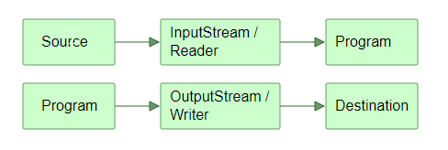
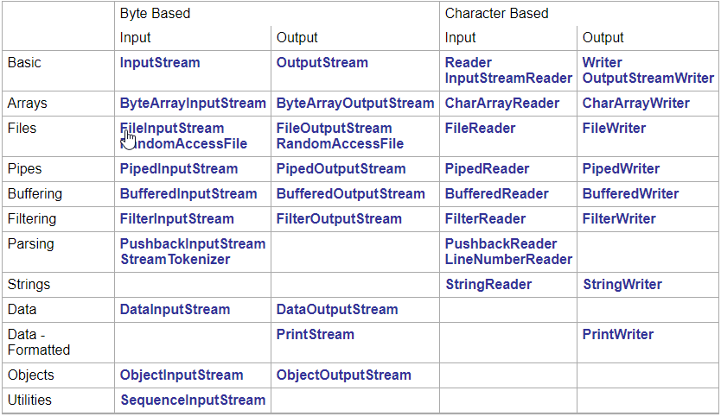
4. Java IO
An InputStream read the data byte by byte without performing any kind of translation (image data, binary file,...)
A Reader is designed for character streams, takes care of the character decoding for you and give you unicode characters from the raw input stream
VII. HELPFUL FEATURES

Slide 78
4. Java IO
Byte Based:
Input Stream: the base class
ByteArrayInputStream: read from byte arrays
FileInputStream: read file
BufferedInputStream: reading of chunks of bytes and buffering
DataInputStream:
Read Java primitives (int, float, long etc.) from an InputStream
Often read data written by a Java DataOutputStream
ObjectInputStream:
Read Java objects from an InputStream
Normally read objects written (serialized) by a Java ObjectOutputStream
The object must implement java.io.Serializable, should also contain a private static final long variable named serialVersionUID. The Java SDK and many Java IDEs contains tools to generate the serialVersionUID
From 2015, many Java projects serialize Java objects using different mechanisms than the Java serialization mechanism (JSON, BSON etc.). This has the advantage of the objects also being readable by non-Java applications
Character Based:
Reader: the base class
CharArrayReader: read from char array
FileReader: read file
BufferedReader : reading a block of characters and buffering
VII. HELPFUL FEATURES

Slide 79
5. Annotation
Annotations, a form of metadata, provide data about a program that is not part of the program itself. Annotations have no direct effect on the operation of the code they annotate
Annotations have a number of uses, among them
Information for the compiler — Annotations can be used by the compiler to detect errors or suppress warnings
Compile-time and deployment-time processing — Software tools can process annotation information to generate code, XML files, and so forth
Runtime processing — Some annotations are available to be examined at runtime
There are several methods available in the Reflection API that can be used to retrieve annotations
VII. HELPFUL FEATURES

Slide 80
5. Annotation
Retention annotation specifies how the marked annotation is stored
RetentionPolicy.SOURCE - only in the source level and is ignored by the compiler
RetentionPolicy.CLASS - retained by compiler at compile time, but is ignored by the JVM
RetentionPolicy.RUNTIME - retained by the JVM so it can be used by the runtime environment
Target annotation marks another annotation to restrict what kind of Java elements the annotation can be applied to
ElementType.ANNOTATION_TYPE
ElementType.CONSTRUCTOR
ElementType.FIELD
ElementType.LOCAL_VARIABLE
ElementType.METHOD
ElementType.PACKAGE
ElementType.PARAMETER
ElementType.TYPE can be applied to any element of a class
VII. HELPFUL FEATURES

Slide 81
6. Regular Expressions
A regular expression (regex) defines a search pattern for strings: a simple character, a fixed string or a complex expression containing special characters describing the pattern
A regex can be used to search, edit and manipulate text, this process is called: The regular expression is applied to the text/string
The regex is applied on the text from left to right. Once a source character has been used in a match, it cannot be reused
Using round brackets to group parts of the regular expression and create a back reference
For advanced regular expressions the java.util.regex.Pattern and java.util.regex.Matcher classes are used
VII. HELPFUL FEATURES

Slide 82
REFERENCES
Overall:
https://docs.oracle.com/javase/tutorial/reallybigindex.html
https://www.geeksforgeeks.org/java/?ref=lbp
https://docs.oracle.com/javase/8/docs/api/index.html?overview-summary.html
Helpful Features:
https://docs.oracle.com/javase/tutorial/java/generics/index.html
https://docs.oracle.com/javase/tutorial/java/javaOO/lambdaexpressions.html
https://www.geeksforgeeks.org/functional-interfaces-java/
https://docs.oracle.com/javase/tutorial/essential/io/index.html
http://tutorials.jenkov.com/java-io/index.html
https://docs.oracle.com/javase/tutorial/java/annotations/
https://www.vogella.com/tutorials/JavaRegularExpressions/article.html
IV. COLLECTIONS

Slide 83
VIII. SPRING FRAMEWORK INTRODUCTION
Inversion of Control
Spring Profiles
VIII. SPRING FRAMEWORK INTRODUCTION

Slide 84
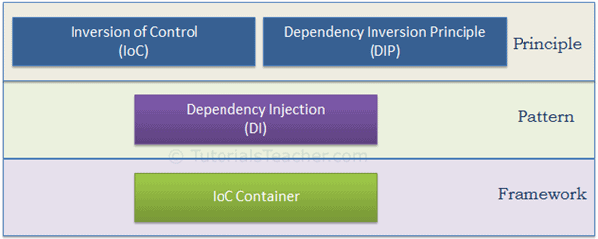
1. Inversion of Control
VIII. SPRING FRAMEWORK INTRODUCTION

Slide 85
1. Inversion of Control
IoC is used to invert different kinds of controls in object-oriented design to achieve loose coupling
Let the taxi driver do the driving so that you can focus on your main work
Controls refer to any additional responsibilities a class has, other than its main responsibility
Control over the flow of a program: GUI events, lambda expressions
Control over the dependent objects creation: dependency injection
Dependency Inversion Principle (DIP)
High-level modules should not depend on low-level modules. Both should depend on the abstraction
Abstractions should not depend on details. Details should depend on abstractions
Dependency Injection Pattern is an IoC implementation, the creation and binding of the dependent objects are moved outside of the class that depends on them
Constructor Injection: use the constructor
Property Injection: use a public property
Setter Injection: use the setter method
VIII. SPRING FRAMEWORK INTRODUCTION

Slide 86
1. Inversion of Control
IoC Container (DI Container) is a framework for implementing automatic dependency injection. It manages object creation and it's life-time, and also injects dependencies to the class
All the containers must provide easy support for the following DI lifecycle
Register: The container must include some way to register type-mapping
Resolve: The container creates an object of the specified type, injects the required dependencies if any and returns the object
Dispose: The container must manage the lifetime of the dependent objects
VIII. SPRING FRAMEWORK INTRODUCTION

Slide 87
2. Spring Profiles
Profiles are a core feature of the framework, allowing us to map our beans to different profiles. We can then activate different profiles in different environments to bootstrap only the beans we need
We use the @Profile annotation to map the bean to that particular profile; the annotation simply takes the names of one (or multiple) profiles
Profile names can also be prefixed with a NOT operator (!dev)
Using the @ActiveProfile annotation to enable specific profiles in tests
Any bean that does not specify a profile belongs to the default profile
Using the spring.profiles.default property to set the default profile
We can access the active profiles from the Environment object by injecting it
Priority when use in Spring Boot(higher to lower)
Property spring.profiles.active in property file annotated with @TestPropertySource
@ActiveProfiles annotation
Environment variable spring_profiles_active
Property spring.profiles.active in application.property in test
Property spring.profiles.active in application.property in main
VIII. SPRING FRAMEWORK INTRODUCTION

Slide 88
REFERENCES
Overall:
https://docs.oracle.com/javase/tutorial/reallybigindex.html
https://www.geeksforgeeks.org/java/?ref=lbp
https://docs.oracle.com/javase/8/docs/api/index.html?overview-summary.html
Spring Framework Introduction:
https://www.tutorialsteacher.com/ioc
https://www.baeldung.com/spring-profiles
VIII. SPRING FRAMEWORK INTRODUCTION

Slide 89
IX. UNIT TESTING
Life Cycle
Test Runner
Rule
IX. UNIT TESTING

Slide 90
1. Life Cycle
Before And After
Methods to setup and tear down the environment or test data
In JUnit, for each test – a new instance of test is created
@BeforeAll/@BeforeClass and @AfterAll/@AfterClass annotations, should be called only once. So they must be declared static
If there are multiple methods annotated with same annotation (e.g. two methods with @BeforeAll) then their execution order is undetermined
@BeforeEach/@Before and @AfterEach/@After are invoked for each instance of test so they need not to be static
Disabling Test
@Disabled/@Ignored annotation, @Disabled can be used for class
Assertions
Assertions help in validating the expected output with actual output
To fail a test, simply use Assertions.fail()
IX. UNIT TESTING

Slide 91
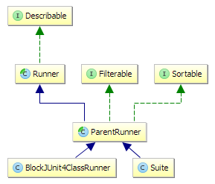
2. Test Runner
IX. UNIT TESTING

Slide 92
2. Test Runner
Define
A JUnit Runner is a class that extends abstract Runner class
Used for running test classes, can be set using @RunWith
Flow
JUnit tests are started using the JUnitCore class
JUnitCore then uses reflection to find an appropriate Runner
BlockJUnit4ClassRunner is the default Runner
Tests are structured and executed in a hierarchical order. ParentRunner is an abstract base class for Runners
Subclasses need to return a list of children(the test class is scanned for methods annotated with @Test using reflection). ParentRunner then asks the subclass to create a Description for each child and finally to run each child
Descriptions contain the information that is later being exported and used by various tools
IX. UNIT TESTING

Slide 93
3. Rule
A TestRule is an alteration in how a test method, or set of test methods, is run and reported. A TestRule may add additional checks that cause a test that would otherwise fail to pass, or it may perform necessary setup or cleanup for tests, or it may observe test execution to report it elsewhere
TestRules can do everything that could be done previously with methods annotated with Before, After, BeforeClass, or AfterClass, but they are more powerful, and more easily shared between projects and classes
Use @Rule for method-level, and @ClassRule for class-level
IX. UNIT TESTING

Slide 94
REFERENCES
Overall:
https://docs.oracle.com/javase/tutorial/reallybigindex.html
https://www.geeksforgeeks.org/java/?ref=lbp
https://docs.oracle.com/javase/8/docs/api/index.html?overview-summary.html
Unit Testing:
https://howtodoinjava.com/junit5/
https://dzone.com/articles/understanding-junits-runner
IX. UNIT TESTING

Slide 95
X. COMMON DESIGN PATTERNS
Creational Patterns
Structural Patterns
Behavioral Patterns
X. COMMON DESIGN PATTERNS

Slide 96
1. Creational - Factory Method
Intent: provides an interface for creating objects in a superclass, but allows subclasses to alter the type of objects that will be created
Problem: adding a new class to the program isn’t that simple if the rest of the code is already coupled to existing classes
Solution
Replace direct object construction calls with calls to a special factory method
Limitation: subclasses may return different types of products only if these products have a common base class or interface. Also, the factory method in the base class should have its return type declared as this interface
X. COMMON DESIGN PATTERNS

Slide 97
1. Creational - Abstract Factory
Intent: produce families of related objects without specifying their concrete classes
Problem: create individual furniture objects so that they match other objects of the same family Also, you don’t want to change existing code when adding new products or families of products to the program.
Solution
Declare interfaces for each distinct product of the product family (e.g., chair, sofa or coffee table). All variants of products follow those interfaces
Declare the Abstract Factory—an interface with a list of creation methods for all products that are part of the product family
For each variant of a product family, create a separate factory class based on the Abstract Factory interface
The client code has to work with both factories and products via their respective abstract interfaces
Usually, the application creates a concrete factory object at the initialization stage. Just before that, the app must select the factory type depending on the configuration or the environment settings
X. COMMON DESIGN PATTERNS

Slide 98
1. Creational - Singleton
Intent: ensure that a class has only one instance, while providing a global access point to this instance
Problem:
Ensure that a class has just a single instance
Provide a global access point to that instance, also protects that instance from being overwritten by other code
Solution
Make the default constructor private
Create a static creation method that acts as a constructor
X. COMMON DESIGN PATTERNS

Slide 99
1. Creational - Prototype
Intent: copy existing objects without making your code dependent on their classes
Problem:
Private fields are not visible from outside of the object
Sometimes you only know the interface
Solution
Declares a common interface for all objects that support cloning and delegates the cloning process to the actual objects that are being cloned
The clone method creates an object of the current class and carries over all of the field values of the old object into the new one
X. COMMON DESIGN PATTERNS

Slide 100
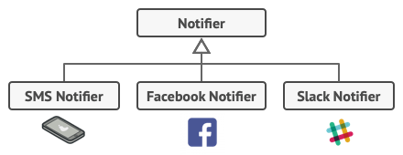
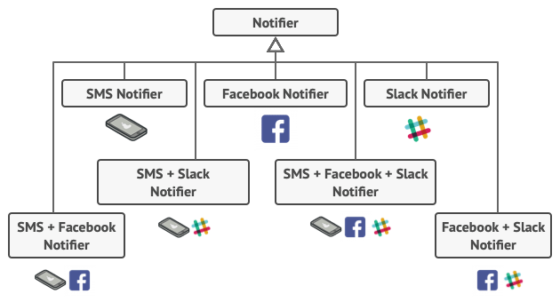
2. Structural - Decorator
X. COMMON DESIGN PATTERNS

Slide 101
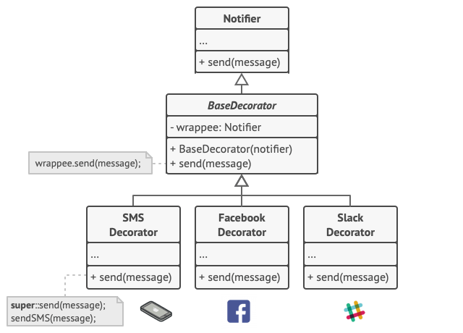
2. Structural - Decorator
X. COMMON DESIGN PATTERNS

Slide 102
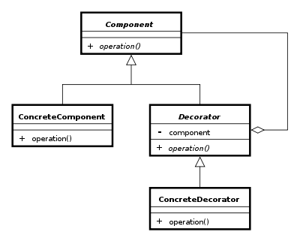
2. Structural - Decorator
Creational methods take an instance of same abstract/interface type and add additional behaviors
X. COMMON DESIGN PATTERNS

Slide 103
2. Structural - Decorator
Declare common methods in an interface
Implement those common methods in a base concrete class
Create a base decorator class which delegates all work to the wrapped object
All decorator classes extend the base decorator, execute its behavior before or after calling to the parent method
Create and compose decorators according to your needs
X. COMMON DESIGN PATTERNS

Slide 104
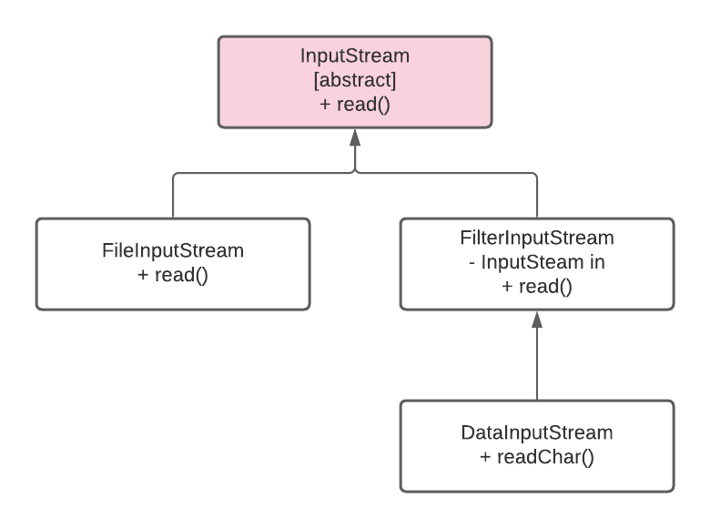
2. Structural - Decorator
X. COMMON DESIGN PATTERNS

Slide 105
2. Structural - Proxy
Intent: provide a substitute or placeholder for another object. A proxy controls access to the original object, allowing you to perform something either before or after the request gets through to the original object
Problem:
you have a massive object that consumes a vast amount of system resources. You need it from time to time, but not always
Solution
create a new proxy class with the same interface as an original service object. Then you update your app so that it passes the proxy object to all of the original object’s clients. Upon receiving a request from a client, the proxy creates a real service object and delegates all the work to it
If you need to execute something either before or after the primary logic of the class, the proxy lets you do this without changing that class
X. COMMON DESIGN PATTERNS

Slide 106
3. Behavior - Mediator
Intent: reduce chaotic dependencies between objects. The pattern restricts direct communications between the objects and forces them to collaborate only via a mediator object
Problem:
Elements can have lots of relations with other elements. Hence, changes to some elements may affect the others
Solution
Cease all direct communication between the components which you want to make independent of each other
These components must call a special mediator object that redirects the calls to appropriate components
X. COMMON DESIGN PATTERNS

Slide 107
REFERENCES
Overall:
https://docs.oracle.com/javase/tutorial/reallybigindex.html
https://www.geeksforgeeks.org/java/?ref=lbp
https://docs.oracle.com/javase/8/docs/api/index.html?overview-summary.html
Common Design Pattern:
https://refactoring.guru/design-patterns
VII. HELPFUL FEATURES

